Slide 1
The 2017 Accomplishments
Of
Meghan Wade
President, Georgia 811

Slide 2
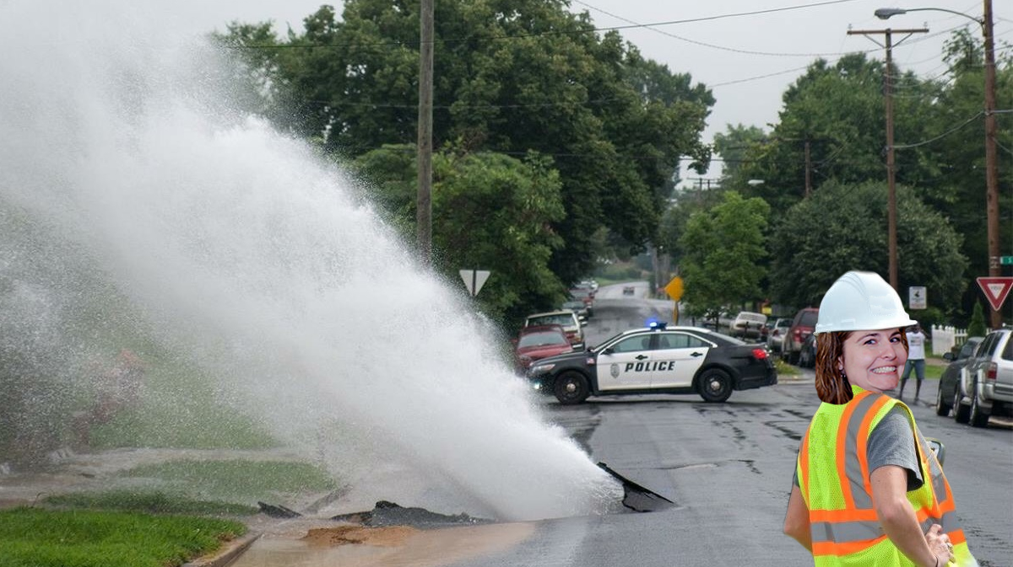
Attempted Her First (And Last) Locate

Slide 3
Competed In A Chili Eating
Competition &
SHE WON!

Slide 4
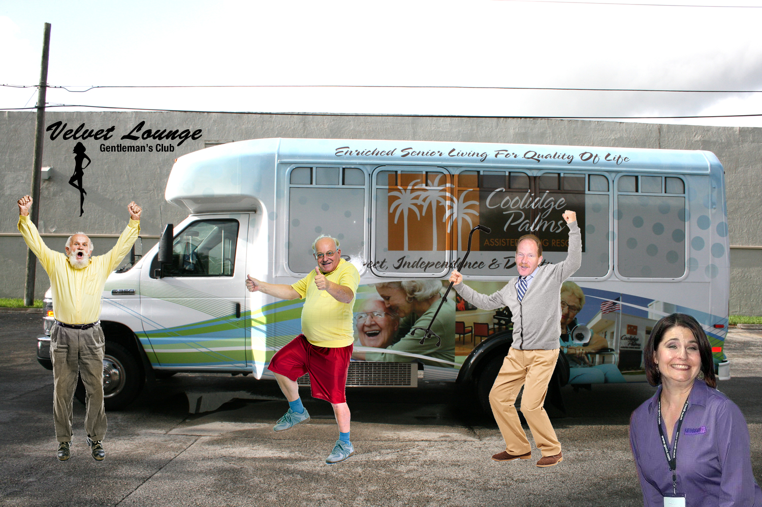
Volunteered Time To Nursing Homes

Slide 5
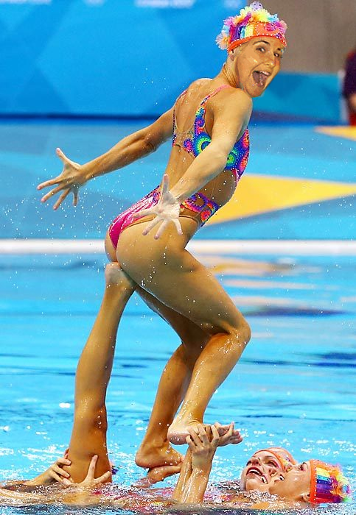
Spent Time As A
Synchronized Swimmer

Slide 6
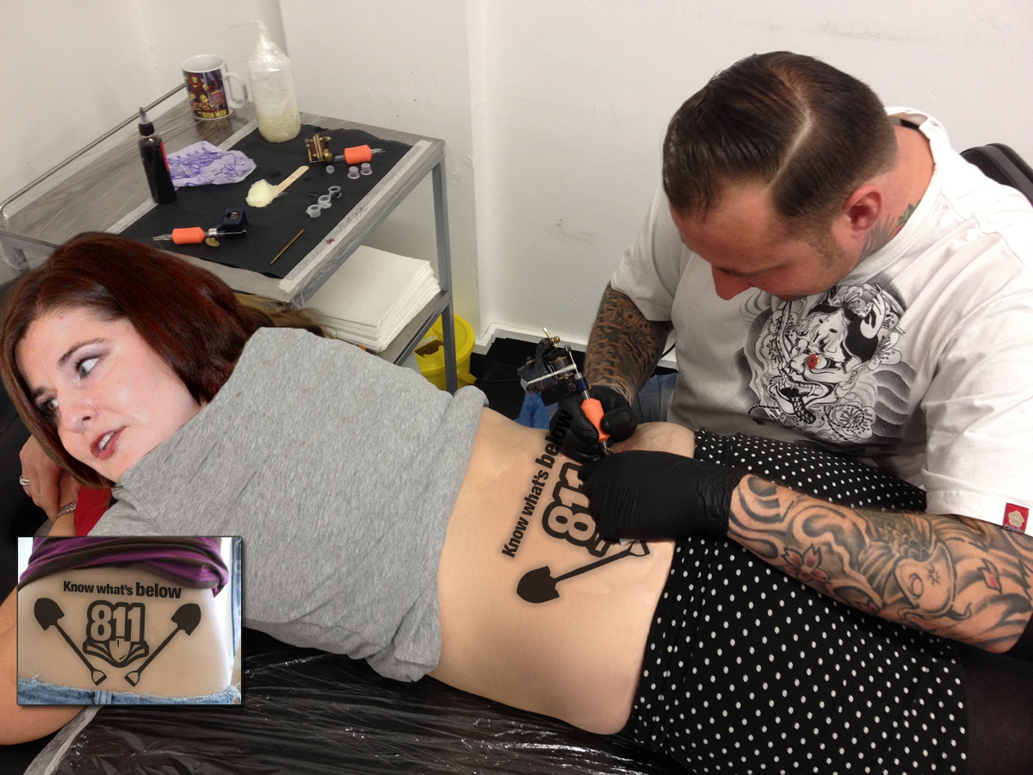
Got Her First Tattoo

Slide 7
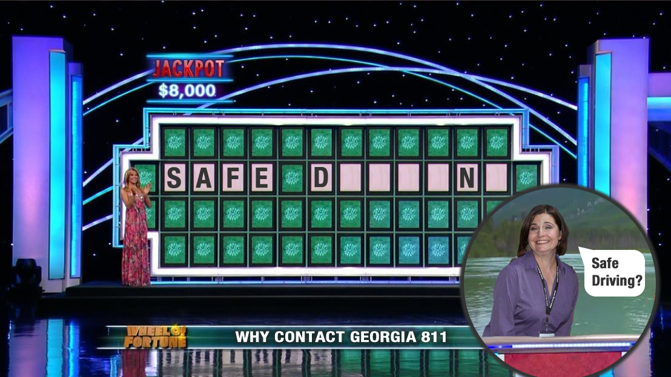
Went On The Wheel Of Fortune (Did Not Win)

Slide 8
Became President of
Georgia 811
(She had the largest hammer)

Slide 9
A Moment Of Triumph

